Slide 1


Group 04
CONTROL DOOR WITH ESP32
Nguyễn Đình Thanh Ngân - 20521646
Phạm Anh Tú - 20522100

Slide 2

The problem
Function Overview
TABLE OF CONTENT
Solution
Workflow
Circuit Diagram
Backend server
Actual Diagram
Demonstration

Slide 3



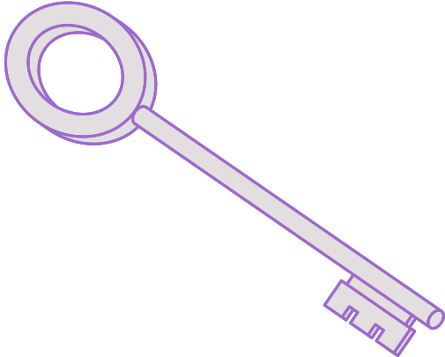

THE PROBLEM
One key for a door
How about this?

Slide 4
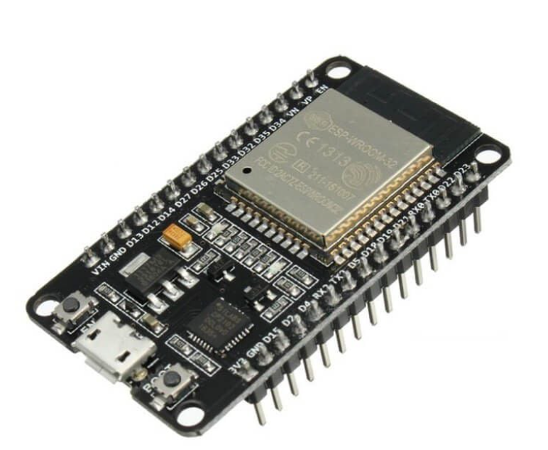



OUR SOLUTION
ESP32
Is a successor to the ESP8266 microcontroller.
Support 2 kinds of wireless communication: Wifi and bluetooth.
Low-cost but high performance.
Ultra-Low power consumption.

Slide 5
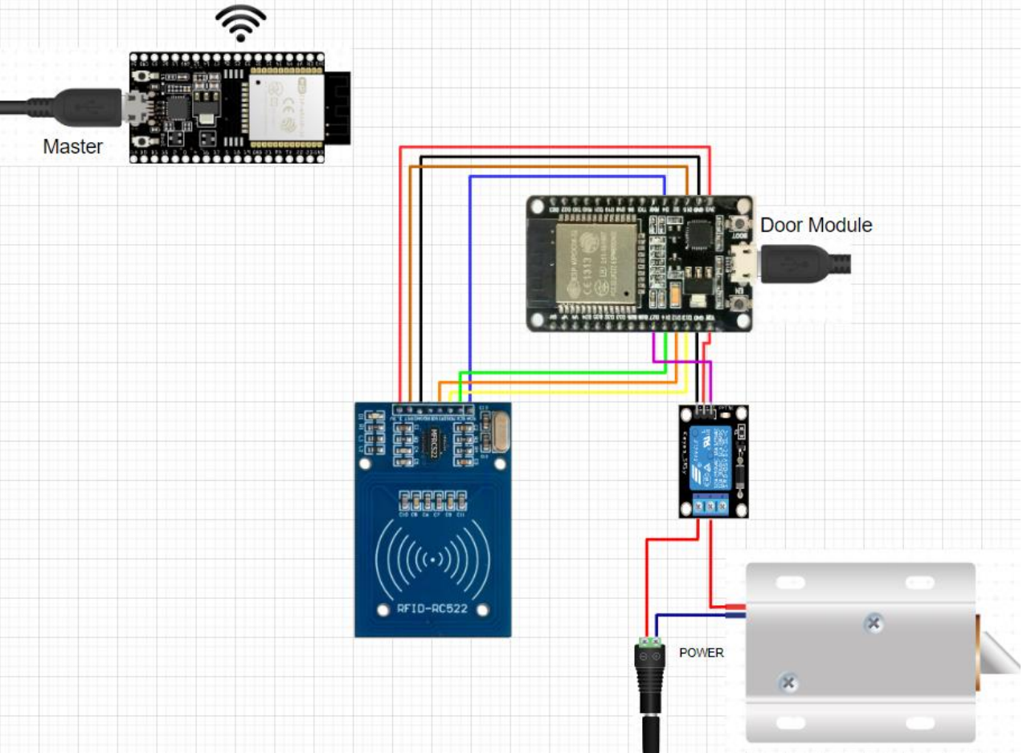
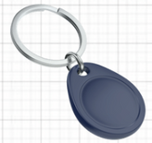
CIRCUIT
DIAGRAM
RELAY
RFID TAG
DOOR LOCK
RFID RECEIVE

Slide 6
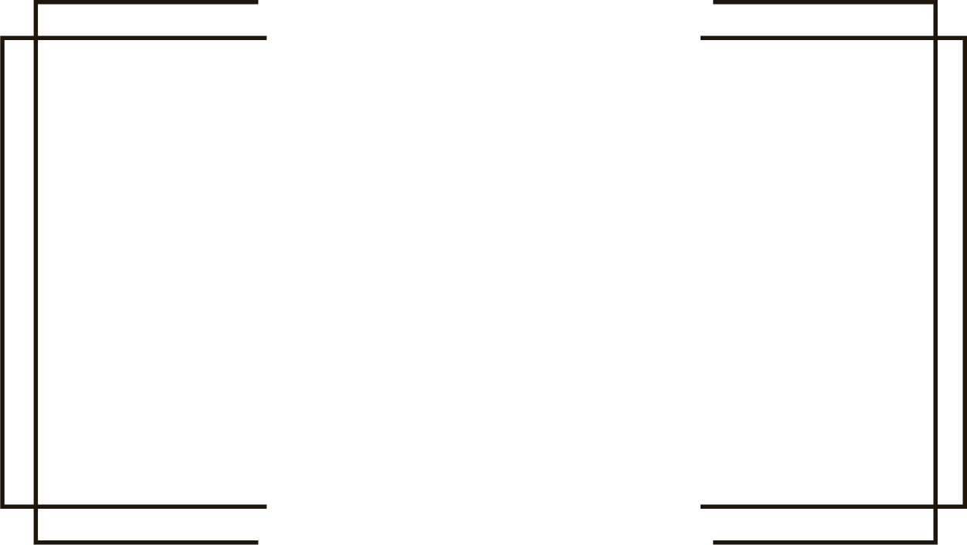



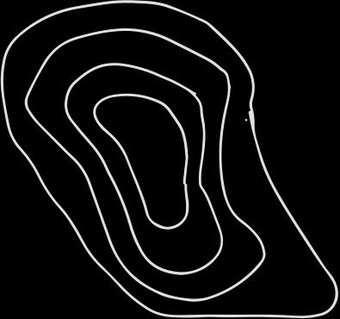

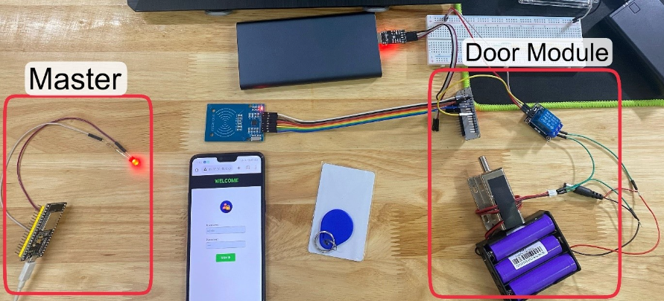


Actual Diagram

Slide 7


FUNCTION OVERVIEW
Look at what the highlight code can do

Slide 8

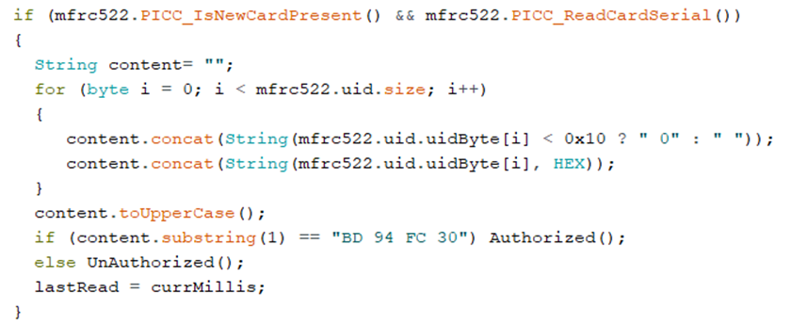
RFID Reader
Will retrieve data from RFID

Slide 9
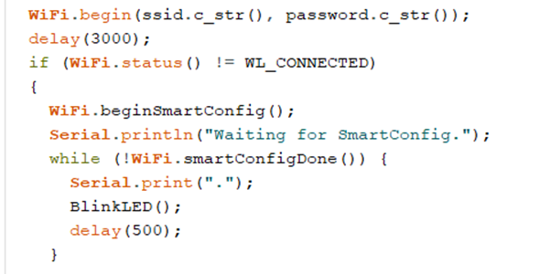
WiFi Smart Config
Will help user config ESP WiFi

Slide 10
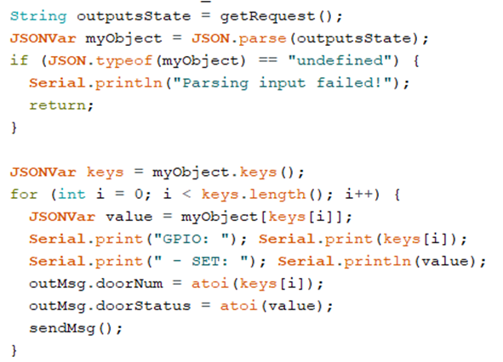
Get Data
Request data and send it to slave

Slide 11
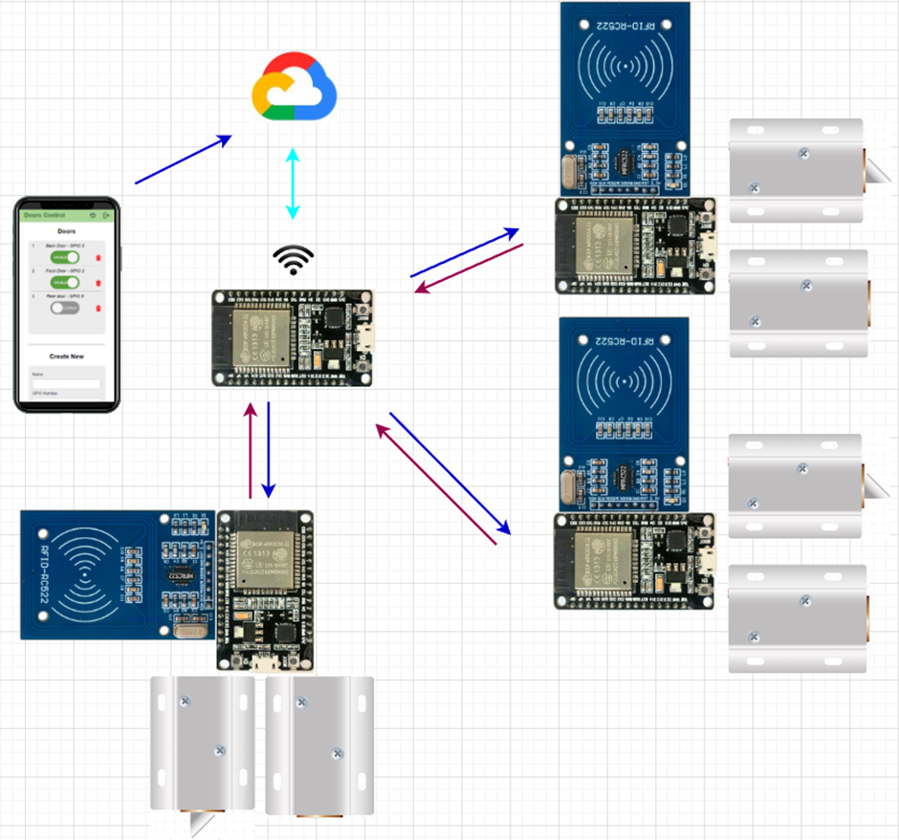
WORKFLOW

Slide 12


HOW ABOUT THE BACKEND?

Slide 13
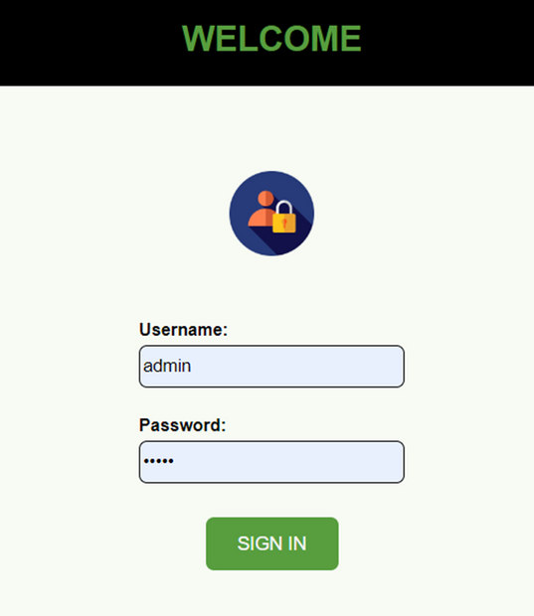
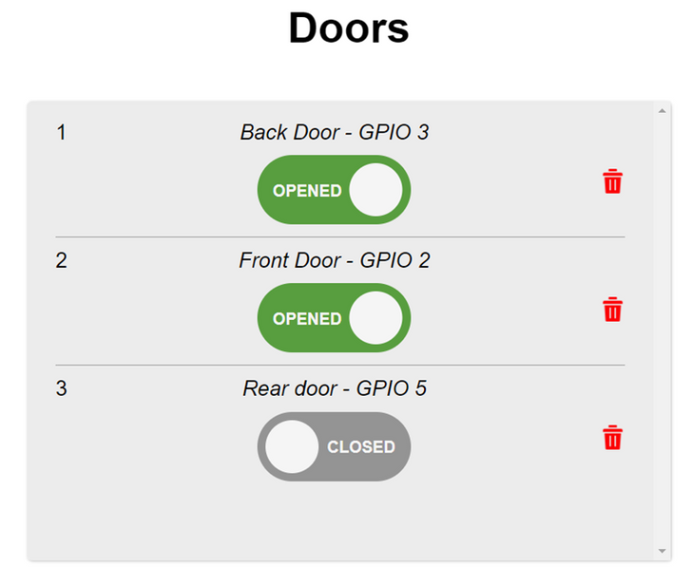
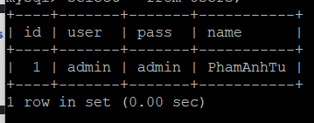
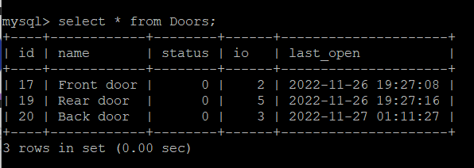
/login.php
/home.php

Slide 14
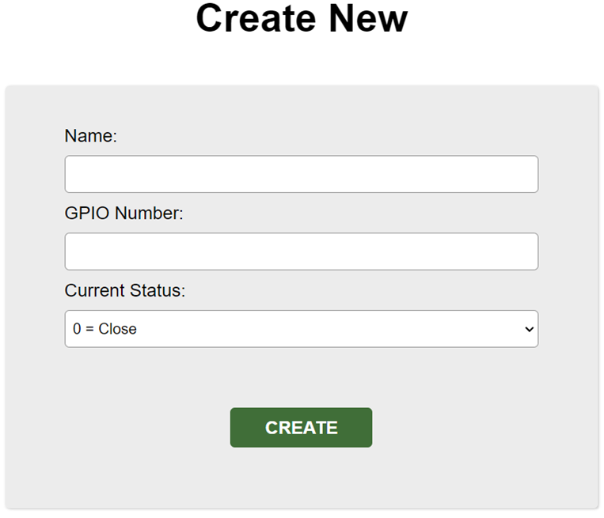
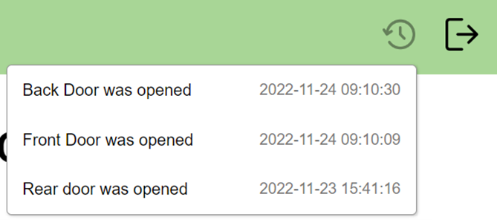

Slide 15


DEMONSTRATION

Slide 16
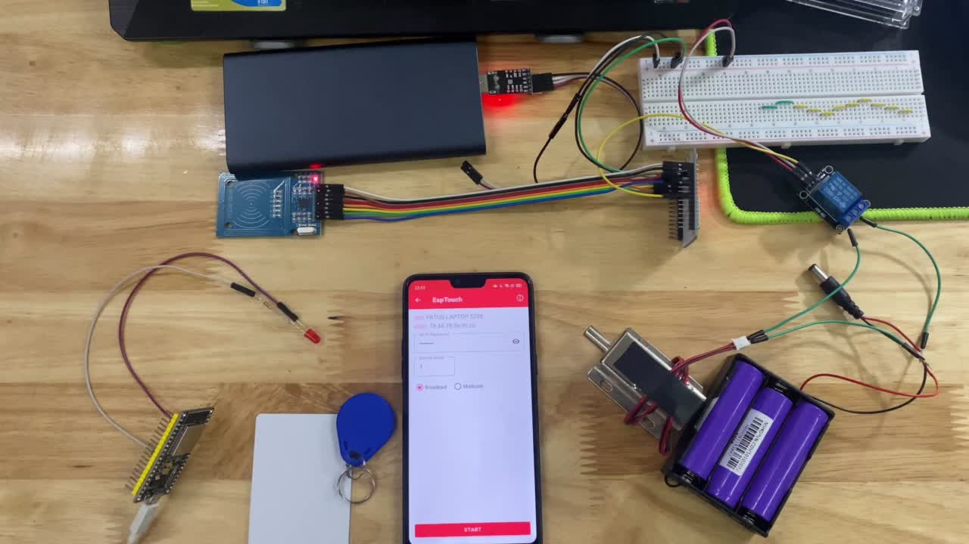

Slide 17
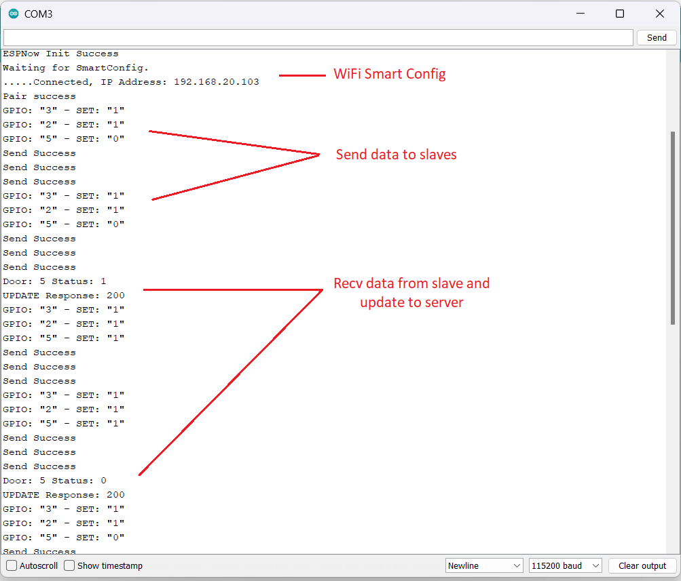

Slide 18
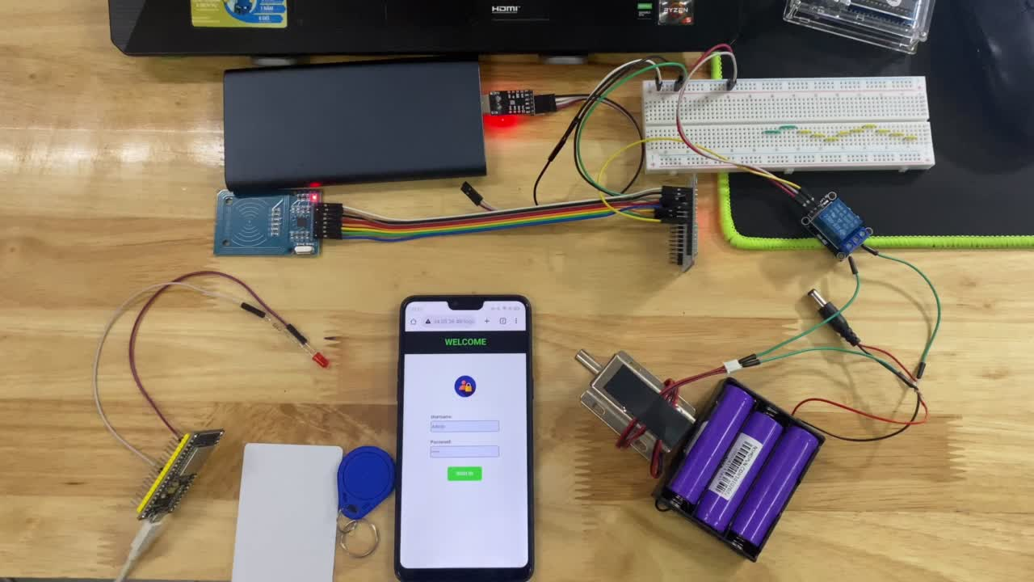

Slide 19
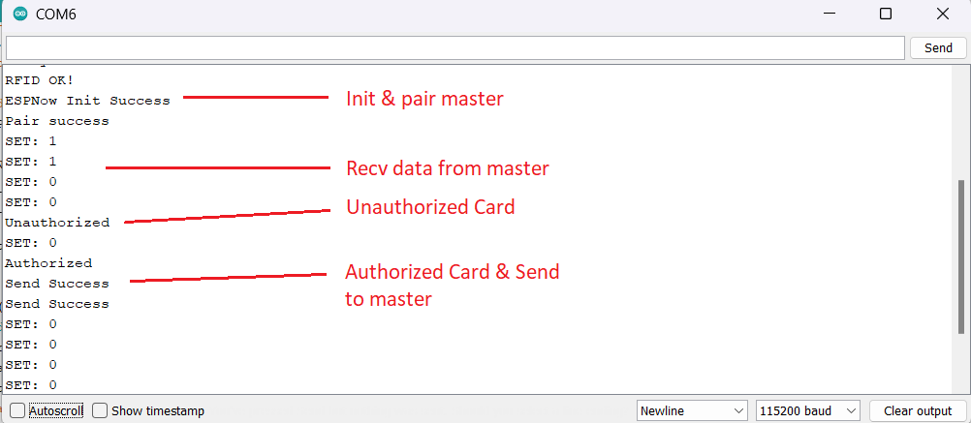

Slide 20
ADD NEW DOOR

Slide 21
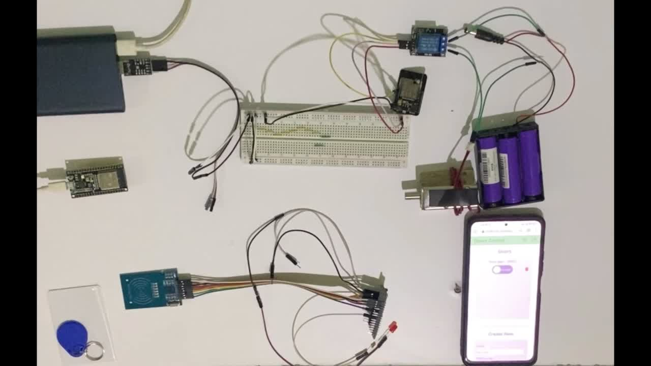

Slide 22




THANK YOU FOR LISTENING!

